Slide 1
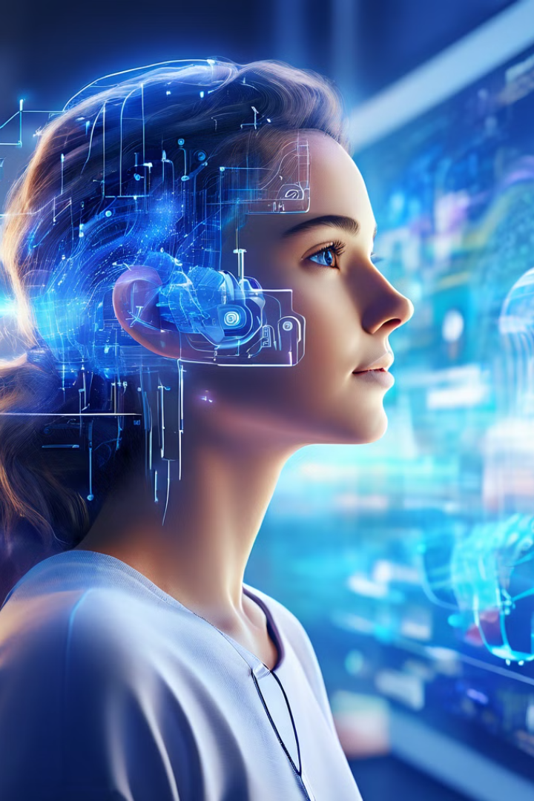

Mental State Mapper
This project presents a framework for analyzing and predicting individual mental states using a comprehensive dataset. This framework utilizes a combination of natural language processing and machine learning techniques to provide insights into mental well-being.
Team Members:
Tulsi Mundada
Osheen Vasudevan
Shweta Pawar
Ruth Gaikwad

Slide 2

Data Preprocessing and Feature Extraction
1
Data Cleaning
The initial step involves cleaning the dataset by removing irrelevant data, handling missing values, and ensuring data consistency.
2
Feature Engineering
Relevant features are extracted from the dataset to represent key aspects of mental health, such as demographics, behavioral patterns, and textual expressions by using Bag of words and TF - IDF.
3
Data Transformation
The extracted features are transformed into a suitable format for machine learning algorithms, often involving normalization or scaling techniques.

Slide 3

Bag of Words and TF-IDF Techniques
Bag of Words (BoW)
Term Frequency-Inverse Document Frequency (TF-IDF)
The BoW model represents text as a collection of words, ignoring word order and focusing on word frequency.
TF-IDF assigns weights to words based on their frequency within a document and their rarity across the entire dataset, highlighting important and unique words.

Slide 4

Sentiment Analysis of Textual Data
1
Sentiment Classification
2
Lexicon-Based Approach
3
Machine Learning Models
Textual data is analyzed to identify the emotional tone, whether it's happy, neutral, depressed or suicidal.
Words and phrases are categorized based on their emotional valence, using pre-defined dictionaries or sentiment lexicons.
Machine learning algorithms are trained to predict sentiment based on textual features and labeled examples.

Slide 5

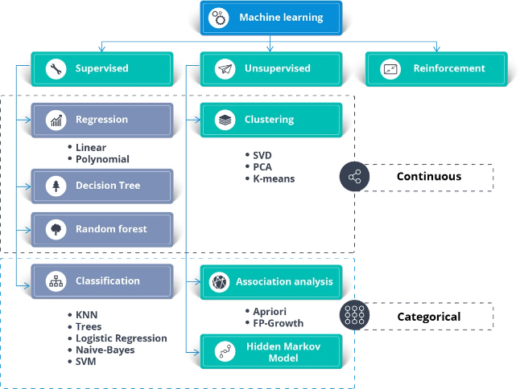
Multinomial Naive Bayes for Prediction
Naive Bayes Algorithm
Training and Evaluation
The multinomial Naive Bayes algorithm is used to predict future mental states based on the extracted features and sentiment analysis results.
The algorithm is trained on a portion of the dataset and evaluated on a separate hold-out set to assess its accuracy and performance.

Slide 6

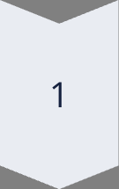
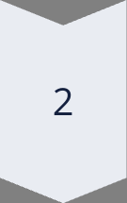
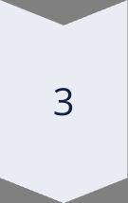
Recommendations for Patients
Personalized Recommendations
Based on the predicted mental state, the framework provides personalized recommendations tailored to the individual's needs.
Therapy Suggestions
Recommendations may include suggestions for therapy, counseling, or self-help resources based on the individual's mental health needs.
Lifestyle Modifications
The framework may suggest lifestyle changes, such as exercise, relaxation techniques, or dietary modifications, to improve well-being.

Slide 7

Potential Applications and Use Cases
Mental Health Monitoring
Early detection and intervention of mental health issues.
Personalized Treatment
Tailoring treatment plans to individual needs and preferences.
Mental Health Research
Gathering insights into mental health trends and patterns.

Slide 8
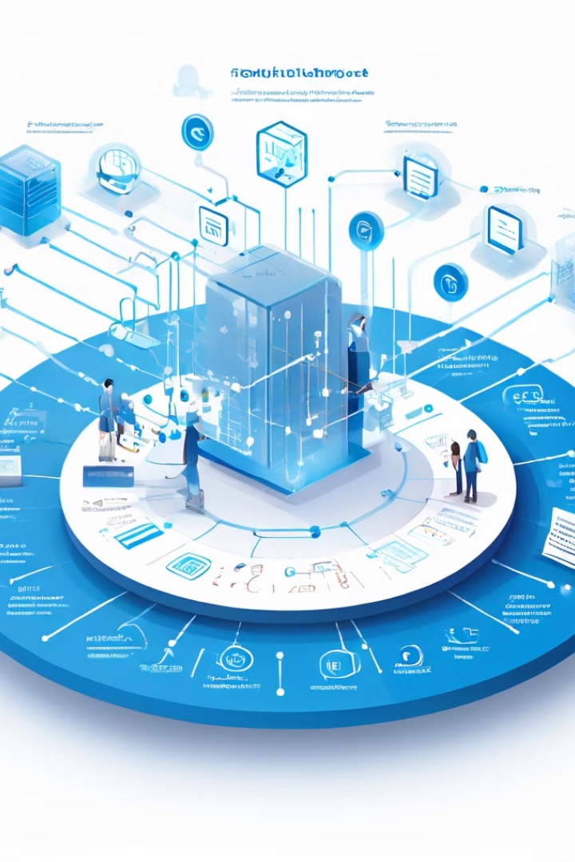
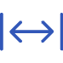

Conclusion and Future Work
Analysis
Future Directions
The framework demonstrates the potential of using data analysis and machine learning to gain insights into mental health.
Further research and development are needed to enhance the accuracy, robustness, and ethical implications of the framework.

